Slide 1
DEVELOPMENT OF A GENERATOR MONITORING AND CONTROL SYSTEM
Name: Kekere-Ekun Ibraheem Ayoola
Matric Number: 18/30GR038
Supervisor: Engr. J.A. Adesina
Date: 07/08/2024

Slide 2
Presentation Outline
Background
Problem Statement
Aims and Objectives
Significance of Project
Scope of Project
Literatures Reviewed
Methodology
Results and Discussion
Conclusion and Recommendations
References

Slide 3
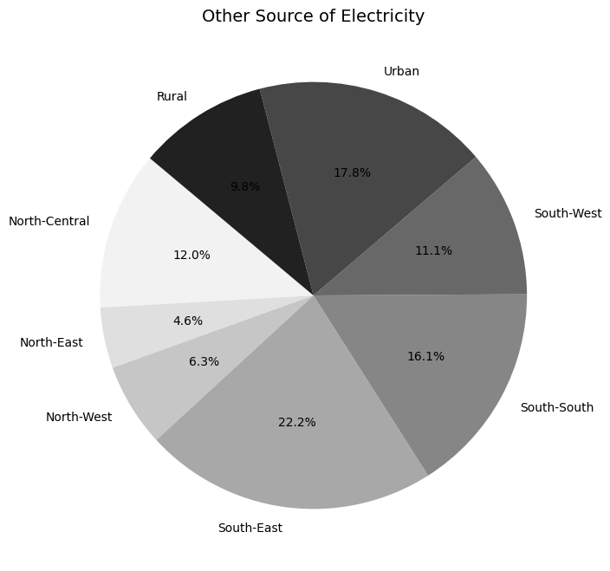
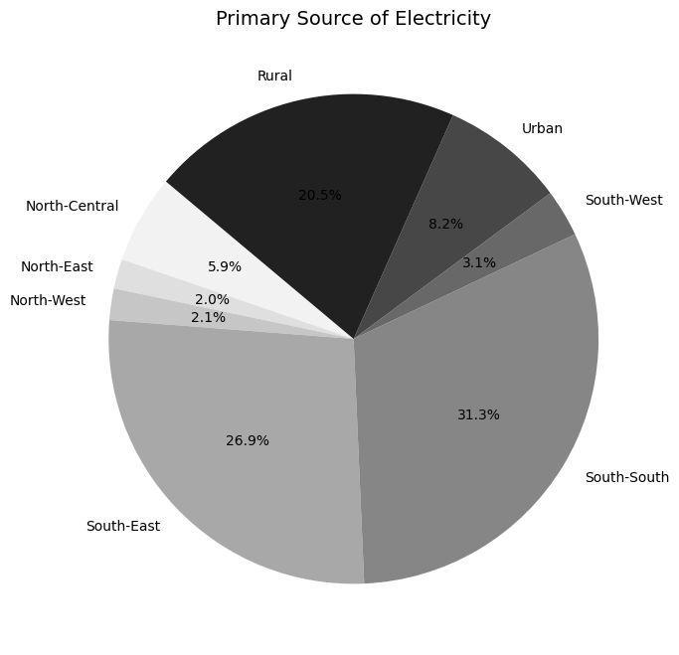
Background
In many regions, particularly Nigeria, unreliable electricity and frequent power outages are common, making generators a crucial alternative power source. This project focuses on developing a generator monitoring and control system designed to manage fuel levels, automate generator operation, and ensure continuous power supply through an automatic transfer switch (ATS). The system integrates real-time monitoring and remote-control capabilities to improve efficiency, safety, and reliability in generator usage, especially in residential and small commercial settings. This comprehensive approach addresses the key challenges faced by users, offering a modern solution to a longstanding problem.
Figure 1: Households using generators a other source of electricity
Figure 2: Households using generators a primary source of electricity

Slide 4
Problem Statement
In Nigeria, unreliable grid electricity has led to widespread reliance on gasoline generators, creating challenges like inefficient fuel use, high costs, and frequent maintenance issues. The lack of seamless transitions between grid and generator power further causes disruptions and safety hazards.
This project aims to address these problems by developing a system with real-time fuel monitoring, remote operation, and an automatic transfer switch. By improving generator efficiency and ensuring continuous power supply, the system seeks to enhance energy reliability and reduce operational costs.

Slide 5
Aim and Objectives
Aim: To develop a generator monitoring and control system using IoT and embedded systems.
Objectives: The objectives of this project are to
implement a system that allows for real-time monitoring of generator fuel level,
design and implement control mechanisms to remotely start and stop the generator,
integrate a system for automatic transfer switching (ATS) between grid power and generator power to ensure seamless power supply in the event of a grid outage, and
develop a user interface that allows users to interact with the system.

Slide 6
Significance of Study
This project modernizes gasoline generator operations, especially in areas with frequent power outages, by replacing manual monitoring and control with automated systems. This reduces human error, minimizes equipment damage, and enhances efficiency. Remote monitoring and control capabilities allow for better generator management, reducing downtime and costs. The system's automatic transfer switch ensures a seamless power supply during grid outages, enhancing electricity reliability.
The project aligns with the United Nations Sustainable Development Goals (SDG 7: Affordable and Clean Energy) by optimizing generator use and improving energy management. It promotes efficient resource utilization and supports access to reliable, modern energy services. The emphasis on automation and technology integration offers a model for upgrading energy infrastructure globally, contributing to more sustainable and resilient energy systems.

Slide 7
Scope of Study
This project aims to develop a comprehensive system for monitoring and controlling gasoline generators, addressing key issues such as fuel management, operational efficiency, and seamless power transition. The system includes real-time fuel level tracking, remote generator control, and an automatic transfer switch (ATS) to ensure continuous power supply during outages.
The project's scope is limited to creating a functional prototype for residential and small commercial applications, specifically in areas with unreliable grid power. The focus is on developing a robust, user-friendly solution without extending into large-scale deployment or commercial production, emphasizing adaptability in similar contexts.

Slide 8
Literatures Reviewed
S/N | Authors | Publication | Findings | Limitations
1 | Kalamkar Pankaj et al | Intelligent Smart Fault Monitoring System For Generator | The Raspberry Pi 2 offers enhanced processing capacity | Bluetooth communication range limitations
2 | S. Boopathi et al | Smart Generator Monitoring System in Industry Using Microcontroller | The PH606 liquid level sensor is employed for monitoring the fuel level | Potential latency due to SMS communication
3 | Muhammad Tahir et al | Real Time Monitoring and Control of Electrical Diesel Generator through Internet of Things | Android application integration enables convenient monitoring and control of the generator from mobile devices. | Compatibility issues or constraints may arise when integrating different hardware components and software modules.
4 | Belen Septian et al | IoT Based Power Monitoring System for Diesel Generator | Employs the SIM900 GSM/GPRS module for transmitting generator parameters to a web server, enabling data collection from sensors, transmission to a VPS via the GPRS network, and streamlined processing and storage in a MySQL database. | Challenges associated with ultrasonic sensor placement and calibration for accurate fuel level measurements, considerations of tank dimensions, environmental factors, and signal interference.

Slide 9
Literatures Reviewed Contd.
5 | Gbenga Daniel Obikoya | Design, construction, and implementation of a remote fuel-level monitoring system | The design and construction of the float-type fuel-level sensor involved careful consideration of geometry and mathematical equations to ensure accurate measurement of fuel volume in the tank | The need for periodic maintenance and calibration of the sensor components adds to the overall operational complexity and cost, potentially impacting the long-term sustainability and effectiveness of the monitoring system.
Methodology
The project methodology involves designing and implementing a generator monitoring and control system using microcontrollers, sensors and actuators. The system integrates fuel level monitoring, automatic start/stop capabilities, and an automatic transfer switch (ATS) to manage power transitions between the grid and generator. It utilizes the MQTT protocol for real-time remote communication, enabling users to monitor and control the generator via a mobile app or web interface, ensuring efficient and reliable operation.

Slide 10
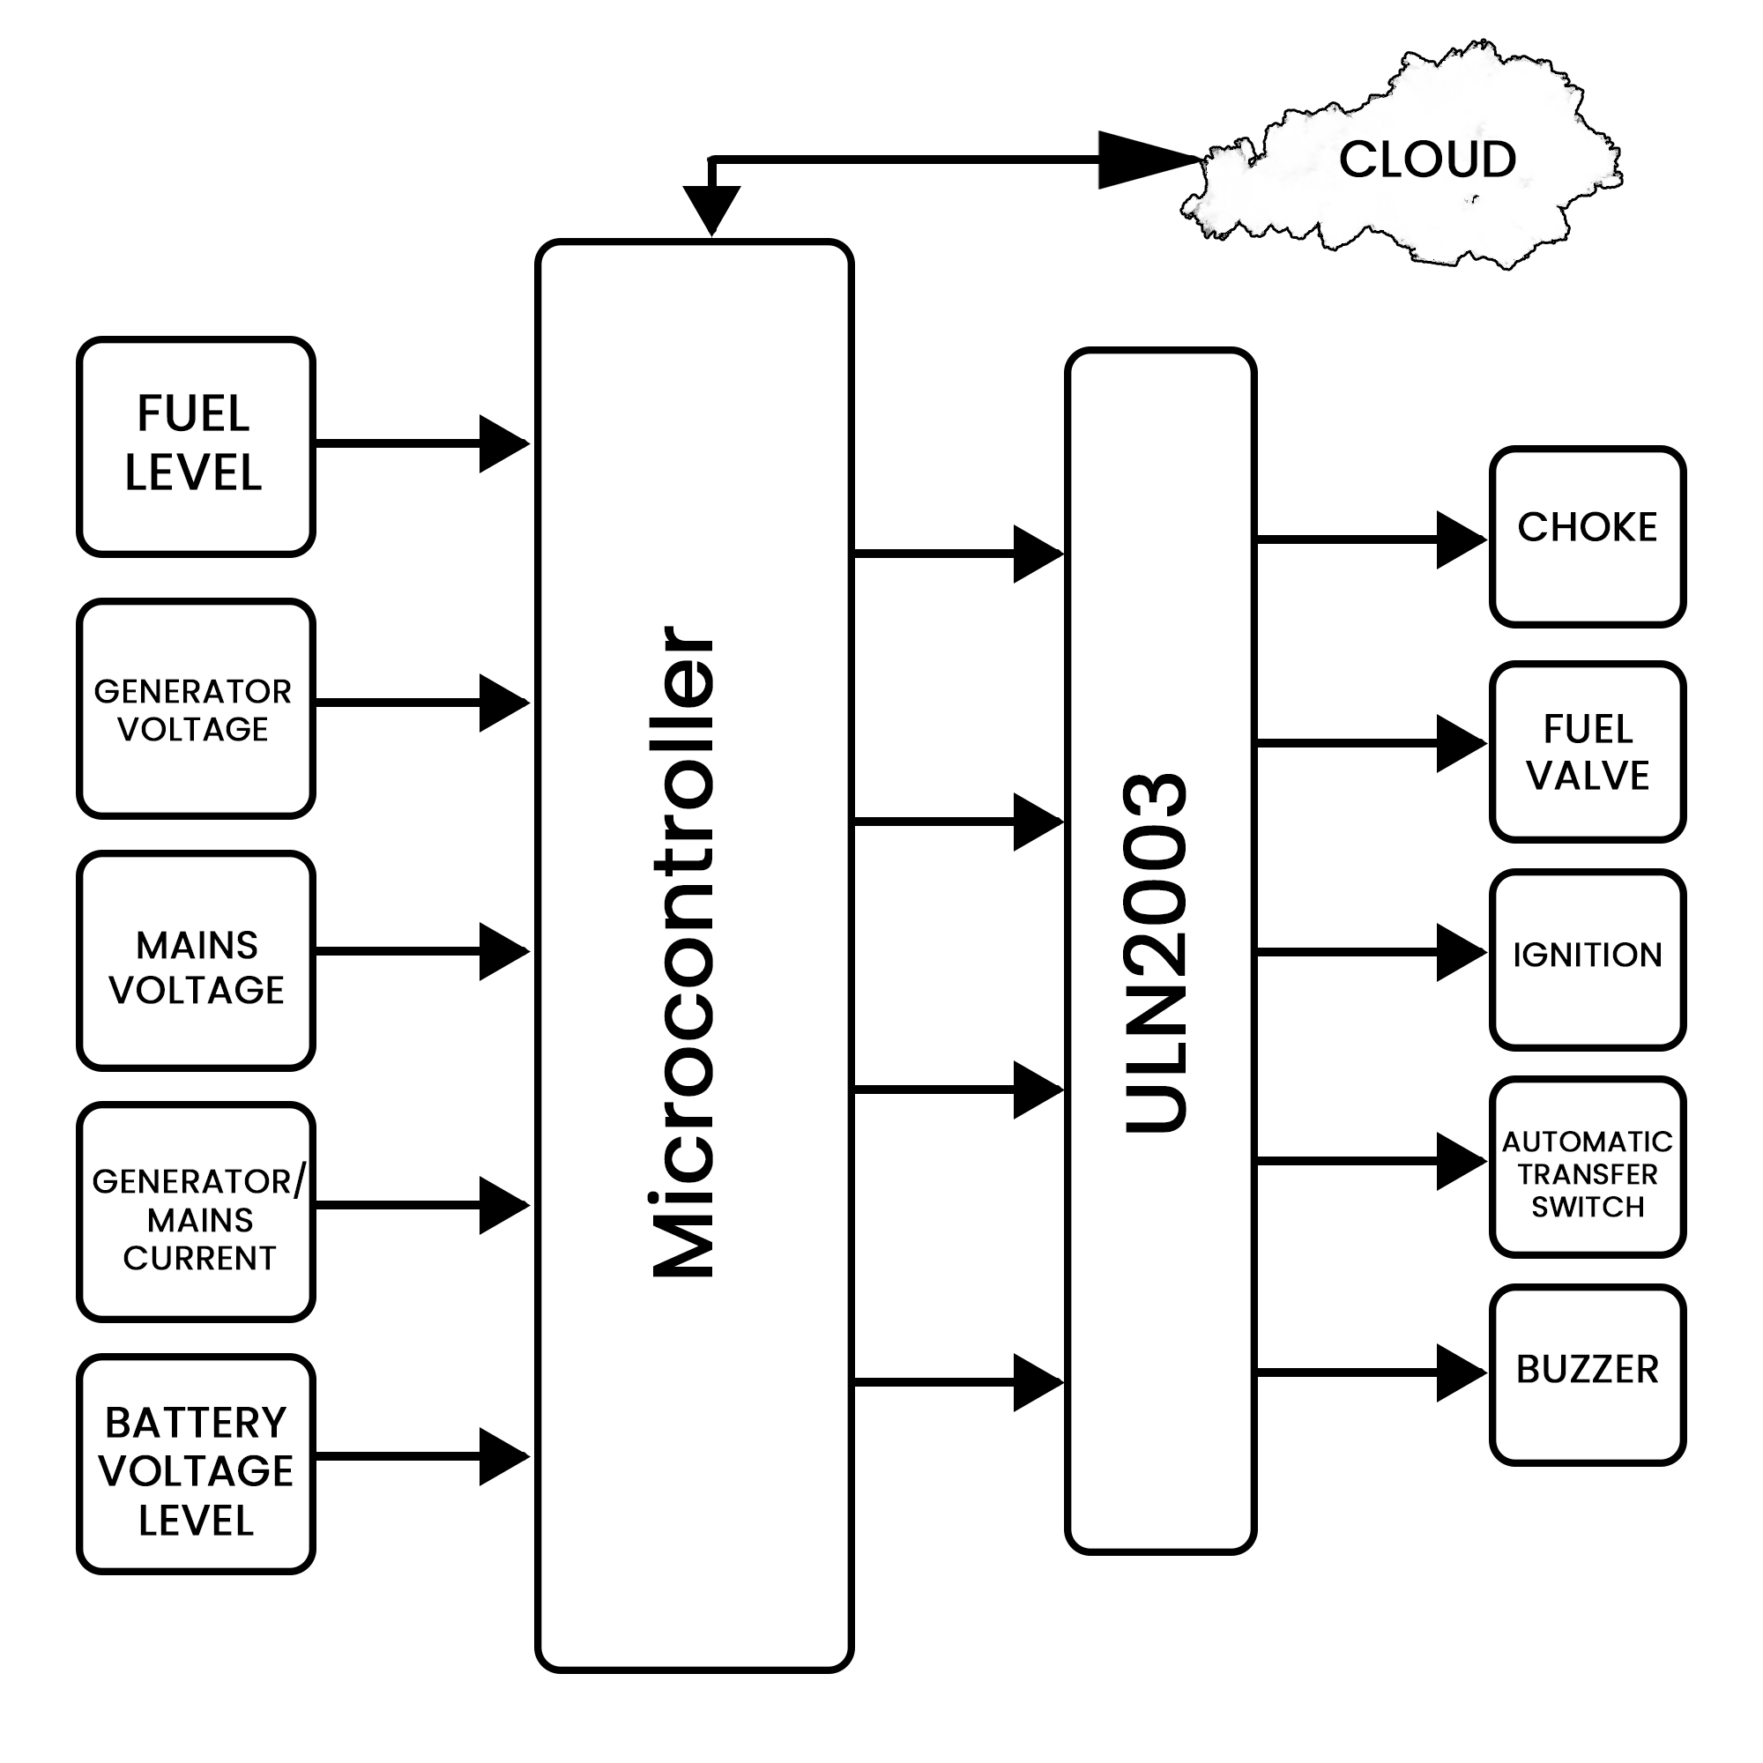
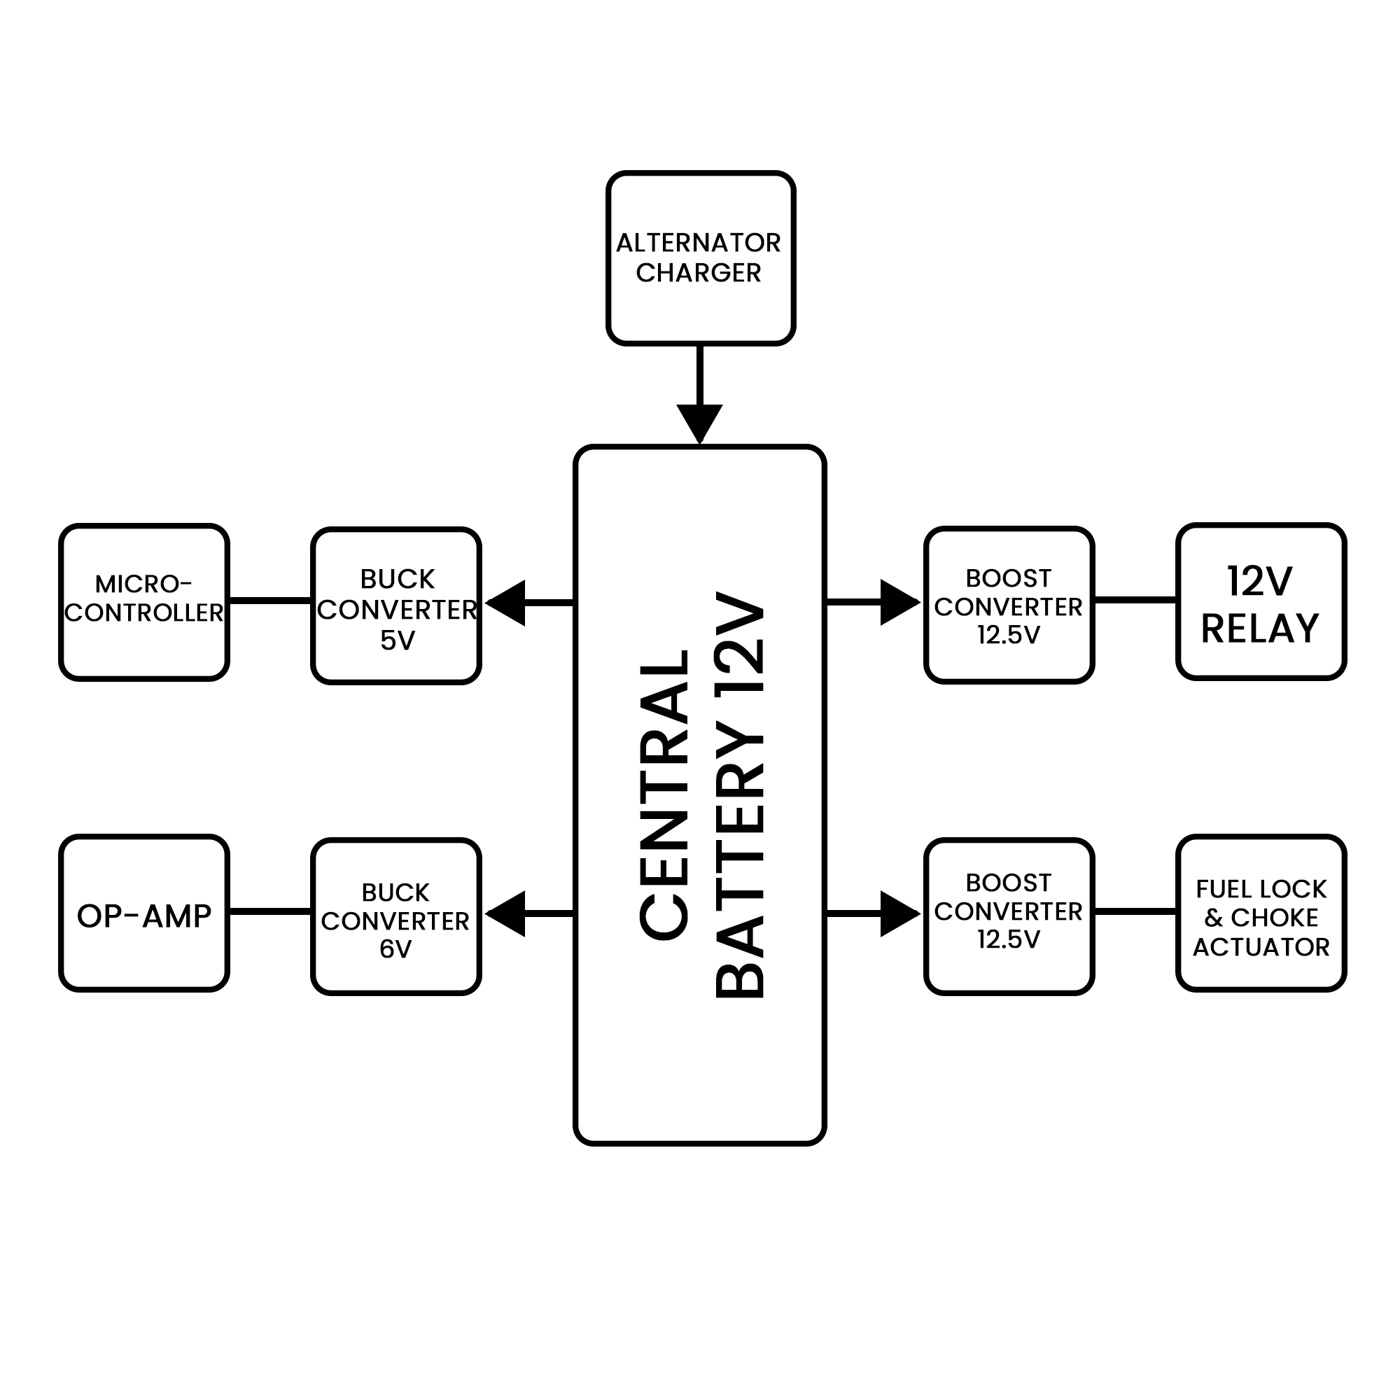
Block Diagram
Figure 3: Block diagram of the system

Slide 11
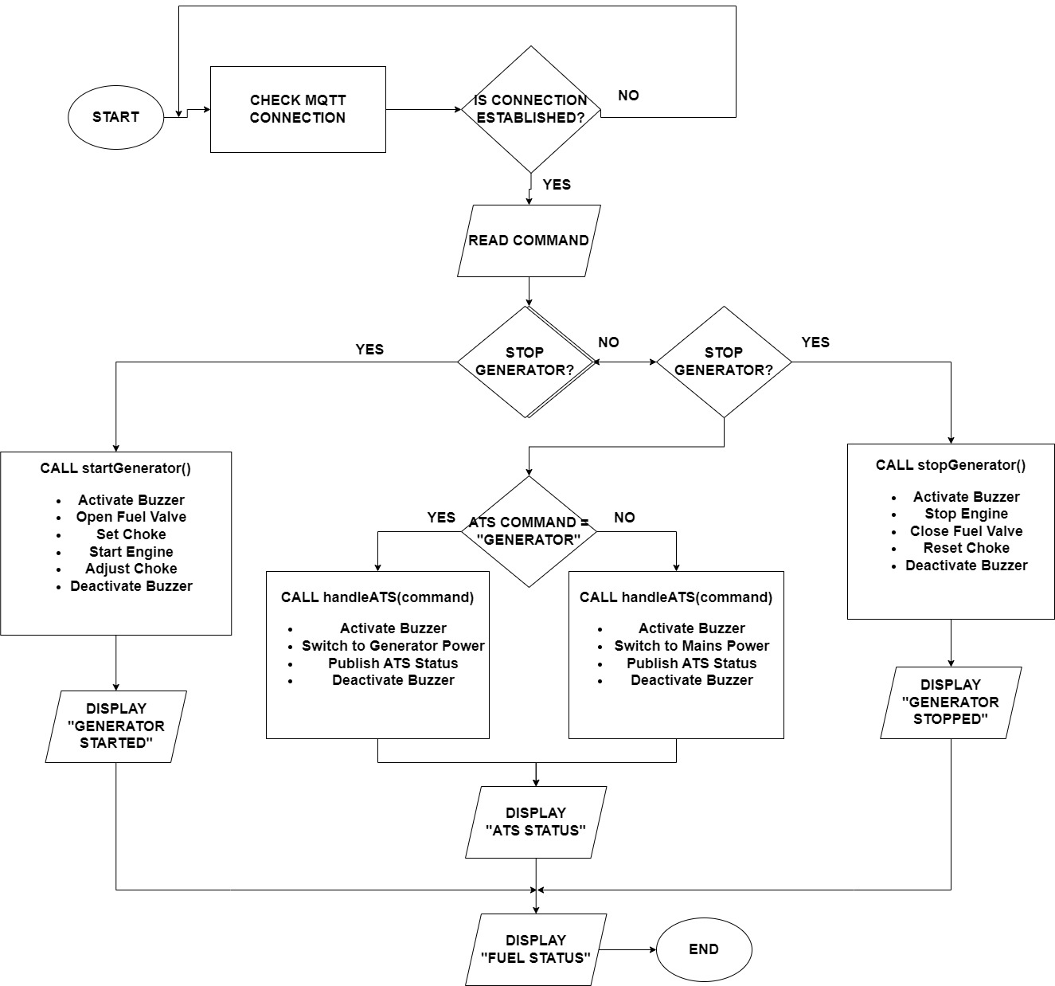
Figure 4: System flowchart

Slide 12
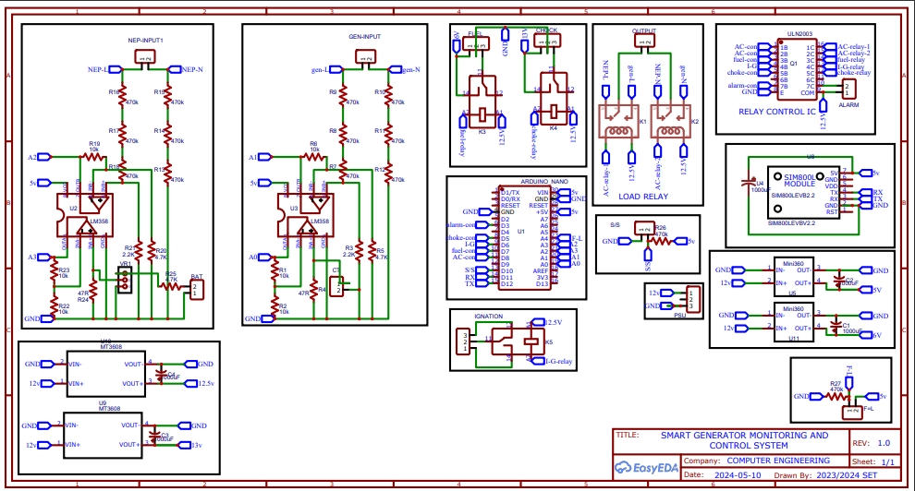
Methodology: Circuit Diagram
Figure 5: Circuit Diagram

Slide 13
RESULTS AND DISCUSSION
Results
The user interface, facilitated through the MQTT protocol, allowed for remote monitoring and control of the system. The ESP8266 microcontroller and associated components, including relays were tested for operational reliability. The relays were able to activate and deactivate corresponding devices, such as the simulated generator starter and fuel valve, as expected. All sensors and actuators were thoroughly tested. They demonstrated accurate and reliable readings, which were successfully transmitted to the monitoring system
Discussion: The system’s sensors, board components, and user interface demonstrated reliable functionality and accurate remote-control capabilities. The testing confirmed that the components effectively communicate and work together to monitor and control generator operations

Slide 14
Conclusion
The project developed and tested a comprehensive system for monitoring and controlling gasoline generators. The system’s performance in terms of component functionality, and user interface efficiency met the expected outcomes

Slide 15
References
Ajibade, A. (2017). Nigeria Imports 70M Generators. The Nation.
Fakehinde, O.B., Fayomi, O.S., Efemwenkieki, U.K., Babaremu, K.O., Kolawole, D.O., & Oyedepo, S.O. (2019). Viability of hydroelectricity in Nigeria and the future prospect. Energy Procedia, 157, 871-878.
Babatunde, O.M., Adedoja, O.S., Babatunde, D.E., & Denwigwe, I.H. (2019). Off‐grid hybrid renewable energy system for rural healthcare centers: A case study in Nigeria. Energy Science and Engineering, 7(3), 676-693.
National Bureau of Statistics. (2019). LSMS Integrated Surveys on Agriculture: Nigeria General Household Survey Panel, Wave 4, 2019. Retrieved from https://www.nigerianstat.gov.ng/pdfuploads/LSMS_Integrated_Panel_Survey_Report.pdf
Kalamkar, P., Waghmare, R., Kendre, P., & Surwade, N. (2017). Intelligent Smart Fault Monitoring System for Generator. International Journal of Advance Research and Innovative Ideas in Education, 3(3), 1869-1873.
Boopathi, S., Jagadeeshraja, M., Manivannan, L., & Dhanasu, M. (2015). Smart Generator Monitoring System in Industry Using Microcontroller. American Journal of Electrical Power and Energy Systems, 4(4), 45-50. doi: 10.11648/j.epes.20150404.13
Tahir, M., Mustafa, S. M. N., Enam, R. N., Ismat, N., & Rizvi, H. H. (2022). Real Time Monitoring and Control of Electrical Diesel Generator through Internet of Things. Pakistan Journal of Engineering, 5(2), 112-118.
Septian, B., Rakesh, P., & Dhora, S. R. (2020). IoT Based Power Monitoring System for Diesel Generator. IEEE International Conference on Recent Advances and Innovations in Engineering (ICRAIE) (pp. 1-6). DOI: 10.1109/ICRAIE51050.2020.9358316
Obikoya. (2014). EURASIP Journal on Wireless Communications and Networking, 2014:76.

